Slide 1

Pipelining: Control Hazards
Alexander Titov
02/22/2014

Slide 2
Refresher: Forwarding + Hazard Detection Unit
Hazard
Detection
Unit
ID/EX.MemRead
IF/ID
ID/EX
EX/MEM
MEM/WB
WB
PC Write
IF/ID Write
Control
0
M
WB
m
u
x
0
1
EX
M
WB
0
1
m
u
x
Instruction
Register
File
2
PC
Instruction
Memory
ALU
Data
Memory
1
0
m
u
x
1
m
u
x
0
2
IF/ID.Rs
Rs
IF/ID.Rt
Rt
IF/ID.Rt
Rt
0
EX/MEM.Rd
IF/ID.Rd
Rd
m
u
x
1
Forwarding
Unit
MEM/WB.Rd
ID/EX.Rt

Slide 3
Executing a BEQ Instruction (1)
beq R4, R5, 27;
# if(R4 - R5 == 0)
# then PC ←(PC + 4) + SignExt(27)*4;
# else PC ← PC+4
0
Calculate branch target
PCSrc
m
u
x
1
IF/ID
ID/EX
EX/MEM
MEM/WB
Add
12
8
4
and
beq
Add
result
RegWrite
Shift
left 2
Add
Branch
PC
Instruction
Read
reg 1
R4
-
MemWrite
Address
Read
reg 2
Read
data 1
ALUSrc
12
Register File
R5
Zero
MemtoReg
Instruction
Write
reg
Read
data 2
0
result
Address
Read
Data
0
Instruction
Memory
m
u
x
ALU
m
u
x
Write
data
1
Data
Memory
1
Write
Data
[15-0]
16
Sign
extend
32
27
6
ALU
Control
0 or
4 beq R4, R5, 27 8 and 12 sw
16 sub
MemRead
[20-16]
0
ALUOp
[15-11]
m
u
x
1
RegDst
Calculate branch condition

Slide 4
Executing a BEQ Instruction (2)
beq R4, R5, 27;
# if(R4 - R5 == 0)
# then PC ←(PC + 4) + SignExt(27)*4;
# else PC ← PC+4
0
8+SignExt(27)*4
PCSrc
m
u
x
1
IF/ID
ID/EX
EX/MEM
MEM/WB
Add
16
12
4
Add
result
sw
RegWrite
and
Shift
left 2
Add
beq
Branch
Instruction
Read
reg 1
-
MemWrite
PC
Address
Read
reg 2
Read
data 1
ALUSrc
R4-R5=0
16
Register File
Zero
MemtoReg
Instruction
Write
reg
Read
data 2
0
result
Address
Read
Data
0
Instruction
Memory
m
u
x
ALU
m
u
x
Write
data
1
Data
Memory
1
Write
Data
[15-0]
16
Sign
extend
32
6
ALU
Control
0 or
4 beq R4, R5, 27 8 and 12 sw
16 sub
MemRead
[20-16]
0
ALUOp
[15-11]
m
u
x
1
RegDst

Slide 5
Executing a BEQ Instruction (3)
beq R4, R5, 27;
# if(R4 - R5 == 0)
# then PC ←(PC + 4) + SignExt(27)*4;
# else PC ← PC+4
0
PCSrc
m
u
x
1
IF/ID
ID/EX
EX/MEM
MEM/WB
Add
20
16
4
Add
result
sub
RegWrite
sw
Shift
left 2
Add
and
Branch
beq
Instruction
Read
reg 1
MemWrite
PC
Address
Read
reg 2
Read
data 1
ALUSrc
20 or 116
Register File
Zero
MemtoReg
Instruction
Write
reg
Read
data 2
0
result
Address
Read
Data
0
Instruction
Memory
m
u
x
ALU
m
u
x
Write
data
1
Data
Memory
1
Write
Data
[15-0]
16
Sign
extend
32
6
ALU
Control
0 or
4 beq R4, R5, 27 8 and 12 sw
16 sub
MemRead
[20-16]
0
ALUOp
[15-11]
m
u
x
1
If the branch is taken the 3 wrong instructions get into the pipeline (they must be canceled somehow)
=> We are loosing 3 cycles after each taken branch!
RegDst

Slide 6
Decision 1: Always Fetch Not Taken
Execute instructions from the fall-through (not-taken) path as if there is no branch
If the branch is not-taken (~50%), no penalty is paid
If branch actually taken:
Flush the fall-through path instructions before they change the machine state (memory / registers)
Fetch the instructions from the correct (taken) path
Assuming ~50% branches not taken on average. How lower it will be that ideal pipeline?
CPI ideal (Clock per instruction) =
1
CPI real =
CPI ideal +
(% of branches × 0.5)
× Penalty =
1.3
~20%
30% slower => need to find something better
3

Slide 7
Decision 2: Delayed Branches
Maybe ask the software (SW) to help?
Need to change ISA to give it such possibility
Define branch to take place AFTER n following instructions
Hardware (HW) executes n instructions following the branch regardless of branch is taken or not
SW puts in the n slots following the branch instructions that can be executed regardless of branch resolution
Instructions that are before the branch instruction, or
Instructions from the converged path after the branch
If cannot find independent instructions, put NOPs
Branch
Only if it doesn’t depend on the instructions in T and NT paths
Only if it doesn’t define the branch condition
Not Taken path
Taken path
Converged path

Slide 8
Decision 2: Delayed Branches
Unfortunately, filling 1 delay slot is easy, 2 is hard, 3 is harder …
Assuming we can effectively fill d% of the delayed slots
CPI real = 1 + 0.2 × (3 × (1-d))
For example, for d=0.6, we get CPI real = 1.2
Mixing architecture with micro-arch
New generations requires more delay slots
Cause computability issues between generations
Still far from the ideal and mixing Arch and uArch is almost always not the best decision.
Can we do something more better?

Slide 9
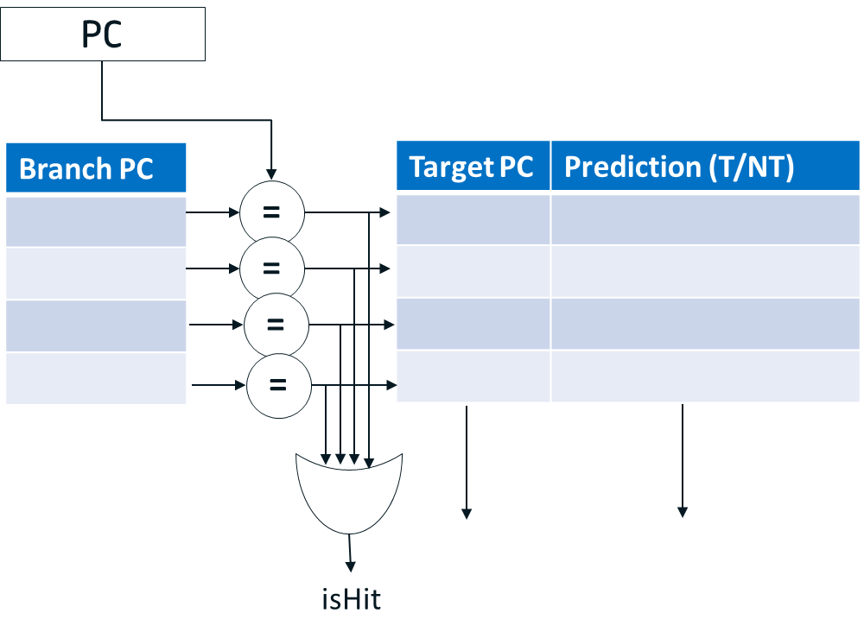
Decision 3: Dynamic prediction
Dynamic branch prediction approach:
As soon as branch is fetched (at IF stage) change the PC to the predicted path.
Switch to the right path after the branch execution if the prediction was wrong.
It required complex hardware at IF stage that will predicts:
Whether the instruction is a branch
Branch taken or not
Taken branch target
Structure performs such function is called Branch Target Buffer (BTB)
In fact, it is organized exactly as a cache

Slide 10
BTB functions
Allocation
Allocate instructions identified as branches (after decode)
Both conditional and unconditional branches are allocated
Not taken branches need not be allocated
BTB miss implicitly predicts not-taken
Prediction
BTB lookup is done parallel to IC lookup
BTB provides
Indication that the instruction is a branch (BTB hits)
Branch predicted target
Branch predicted direction
Branch predicted type (e.g., conditional, unconditional)
Update (when branch outcome is known)
Branch target
Branch history (taken / not-taken)

Slide 11
BTB functions
Wrong prediction cases
Predict not-taken, actual taken
Predict taken, actual not-taken, or actual taken but wrong target
In case of wrong prediction – flush the pipeline
Reset latches (same as making all instructions to be NOPs)
Select the PC source to be from the correct path
Need get the fall-through with the branch
Start fetching instruction from correct path
Assuming P% correct prediction rate
CPI real = 1 + (0.2 × (1-P)) × 3
For example, if P=0.85 (the modern predictors has > 0.95)
CPI real = 1 + (0.2 × 0.15) × 3 = 1.09

Slide 12
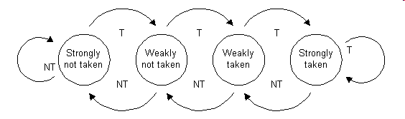
Branch history: bimodal predictor
A saturating counter or bimodal predictor is a state machine with four states:
Why four states?
Bimodal predictor make only one mistake on a loop back branch (on the loop exit)
Advantages:
Small – only 2 bits per entry in the BTB
Predicts well branches with stable behaviour
Disadvantages
Cannot predict well branches which often change their outcome:
e.g. T, NT, T, NT, T, NT, T, NT, T, …

Slide 13
Two-level adaptive predictor
present
future
past
Pattern history table
00
strongly
NT
weakly
NT
weakly
T
strongly
T
Branch sequence:
1 0 0 1 0 0 1 0 0
01
strongly
NT
weakly
NT
weakly
T
strongly
T
History buffer
10
strongly
NT
weakly
NT
weakly
T
strongly
T
Prediction:
0 0 0 0 0 1 0 0 0
11
strongly
NT
weakly
NT
weakly
T
strongly
T
TRUE
Result:
FALSE

Slide 14
Using The BTB
PC moves to next instruction
Inst Mem gets PC
and fetches new inst
BTB gets PC
and looks it up
IF
yes
no
BTB Hit ?
yes
Br taken ?
no
IF/ID latch loaded
with new inst
PC ← perd addr
PC ← PC + 4
ID
IF/ID latch loaded
with pred inst
IF/ID latch loaded
with seq. inst
Branch ?
EXE
yes
no

Slide 15
Using The BTB
ID
yes
no
Branch ?
EXE
Calculate br
cond & trgt
continue
Update BTB
yes
Corect
pred ?
no
MEM
continue
Flush pipe &
update PC
WB
IF/ID latch loaded
with correct inst

Slide 16
Adding a BTB to the Pipeline
Flush
taken target
m
u
x
0
PC+4 (Not-taken target)
PCSrc
MEM
/WB
1
EX/MEM
2
3
IF/ID
ID/EX
Mis-
predict
Detection
Unit
predicted direction
predicted target
+
PC+4 (Not-taken target)
4
RegWrite
+
PC
BTB
Shift
left 2
Branch
Instruction
Read
reg 1
MemWrite
pred target
Read
reg 2
Read
data 1
ALUSrc
pred dir
Register File
Zero
MemtoReg
direction
Write
reg
Read
data 2
0
result
Address
Read
Data
1
target
m
u
x
ALU
alloc/updt
Write
data
m
u
x
4
−
address
1
Write
Data
Data
Memory
0
Address
[15-0]
16
Sign
extend
32
6
ALU
Control
MemRead
Instruction
[20-16]
Inst.
Memory
0
ALUOp
m
u
x
[15-11]
1
RegDst

Slide 17
Acknowledgments
These slides contain material developed and copyright by:
Lihu Rappoport (MAMAS/Intel), 234267, L2

